Slide 1

Advanced Gamma-Ray Science
Methods and Tools
K.Kosack, J.Decock
CEA Saclay – Irfu/Sap
November 29, 2016
Notes:
15mn de présentation + 5mn pour les questions.
Hello everyone
I'm Jeremie Decock
I'm Postdoc at CEA Saclay
I work in the astrophysics division under the supervision of Karl Kosack
And I will briefly introduce our work on advance image cleaning
for gamma-ray science

Slide 2



PRoject Context:
group development
Goal of young-team project:
(Europe)
Improve sensitivity of modern ground-based Gamma-ray telescopes
Develop a group to work on gamma-ray techniques locally at CEA
Improve overlap with related groups
Involve new people in gamma-ray analysis
HESS group
(SAp + SPP)
SAp CTA Group
UnivEarths
Advanced Gamma Project
ASTRI (Inaf)
CosmoStat Group (SAp)
APC Group
(Paris Diderot)
Notes:
The goal of our project is to improve the sensitivity fo …
Make a working group on gamma ray technics in the astrophysics division in CEA
Increase collaboration with others related groups ; for instance we collaborate with …
Involve …

Slide 3
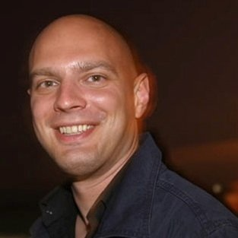
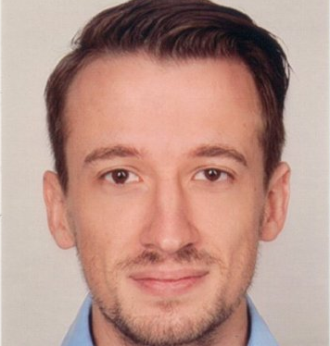
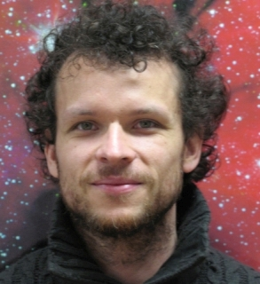
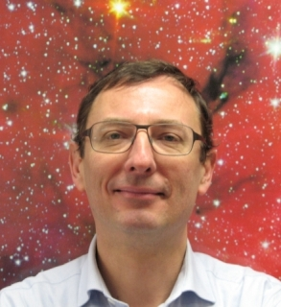
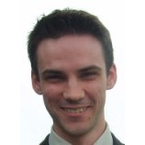
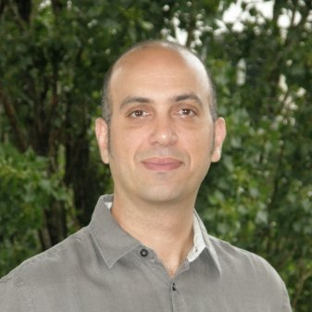
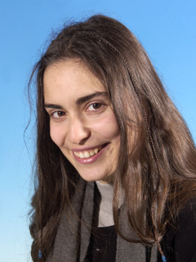
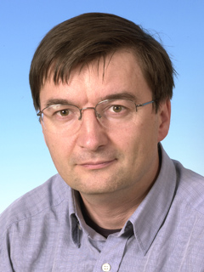
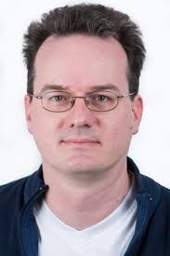
PROJECT MANAGEMENT:
The Team
WP Leader
Jérémie Decock
Karl Kosack
Tino Michael
Fabio Acéro
Thierry Stolarczyk
+
CEA/AIM
CEA/AIM
CNRS/AIM
CEA/AIM
UnivEarths post-doc
Doctor of Computer Science, Inria
Numerical techniques and software development
Mathematical optimization
Signal processing
CTA, ASTERICS
CTA, Fermi
CTA (leader)
HESS, CTA
Bruno Khélifi
Sandrine Pires
David Landriu
Fabian Schüssler
CNRS/APC
CEA/AIM
CEA/AIM
CEA/SPP
HESS, CTA
CosmoStat
Euclid, Kepler
Fermi, CTA
HESS
Notes:
here is our core team.
Here I am,
I'm not an astrophysicist,
I'm a computer scientist,
I've a PhD in mathematical optimization
and I mostly interact with Karl Kosack, Tino Michael, …

Slide 4
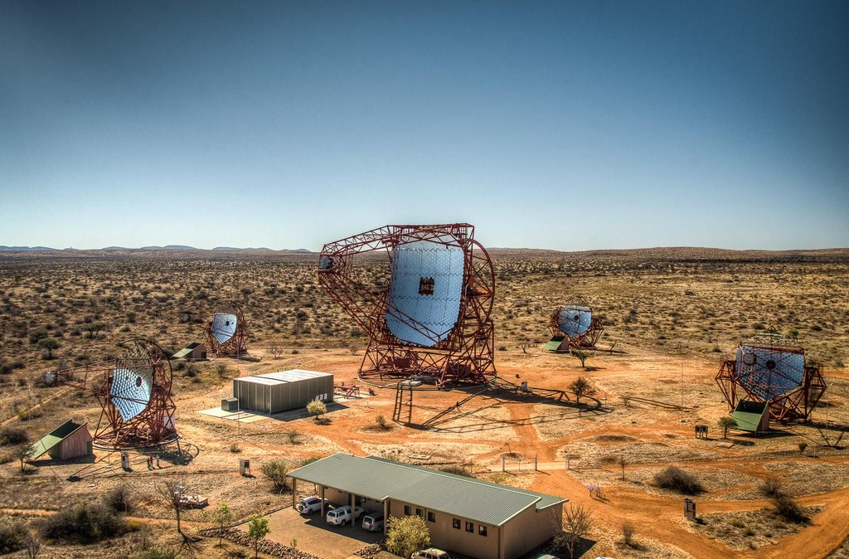
Observatories: HESS
Notes:
So, as I said, we work on gamma ray observatories,
mainly on HESS...

Slide 5
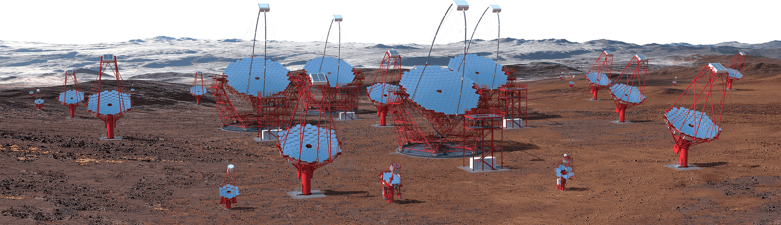
Observatories: CTA
Notes:
... and CTA, the future big Cherenkov Telescope Array

Slide 6
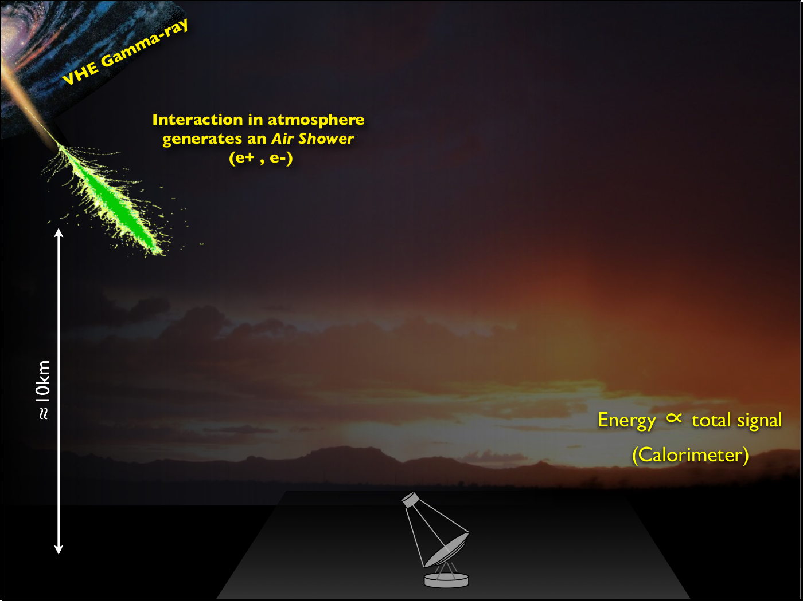
How Cherenkov Telescopes Work
Notes:
The aim of those observatories is to observe extremely energetic sources in the universe
i.e. events that emits extremely short wavelengths photons like supernovae
(up to several TeV) ;
those observations are made through indirect detection of gamma rays
using the Cherenkov effect in the atmosphere

Slide 7
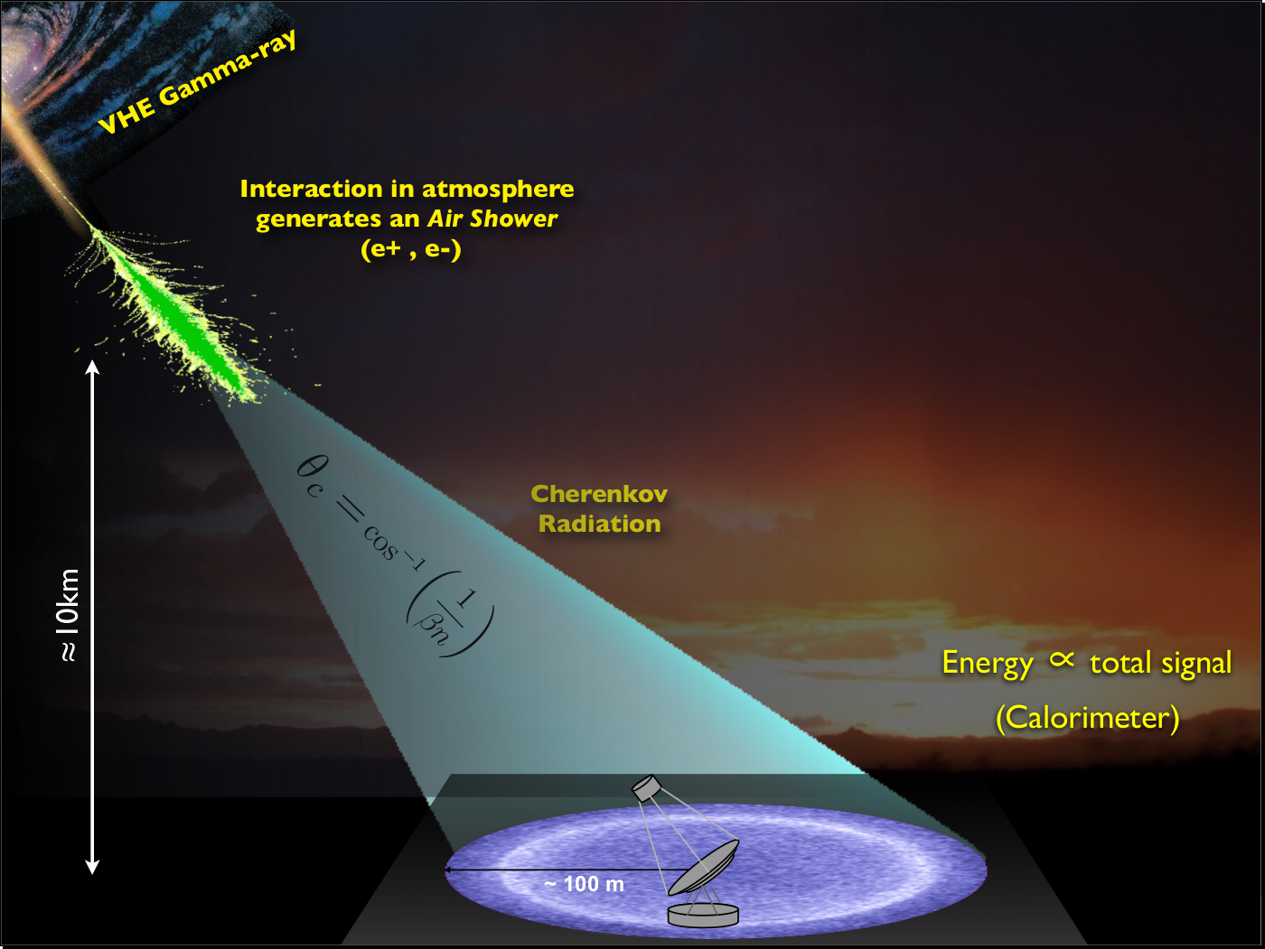
Gamma-rays produce air showers
glow in Cherenkov light
detected by very sensitive optical telescopes
Notes:
When gamma rays come on earth,
they are stopped by the atmosphere
and doing so, they emit a brief flash called air showers
(that's the Cherenkov effect which is more or less the light equivalent of supersonic plane's sonic booms)
those air showers are observed by very sensitive telescopes

Slide 8
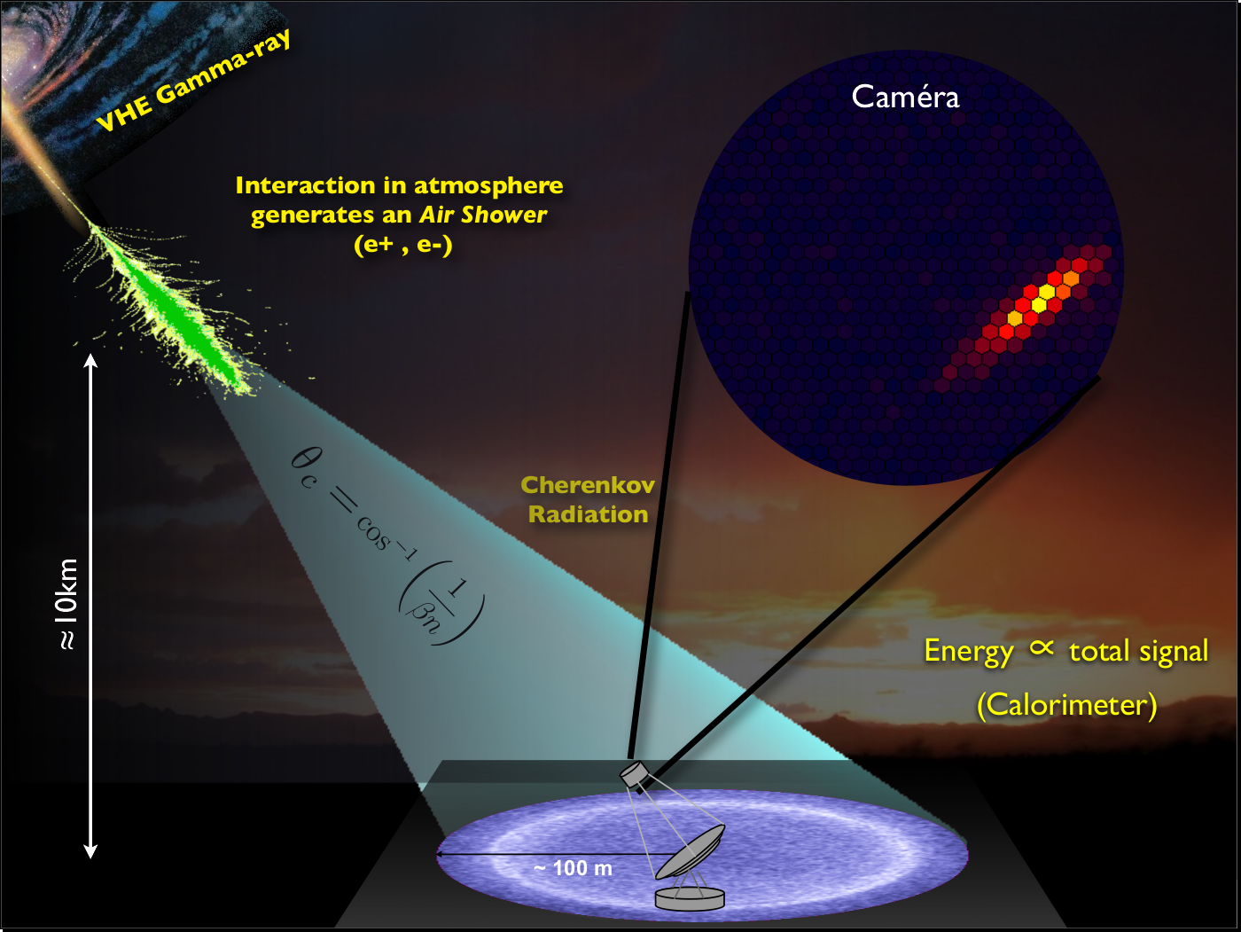
Cameras image showers at ns timescales
very low S/N
Notes:
The time scale are very small (few nano seconds)
and this is the kind of images we get…
This is an ideal case because usually the signal over noise ratio is quite bad

Slide 9
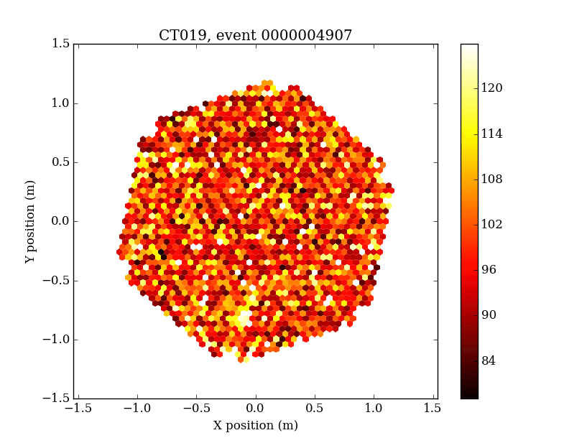
Example
Notes:
... like this
The time scale of these animations is few nano seconds

Slide 10
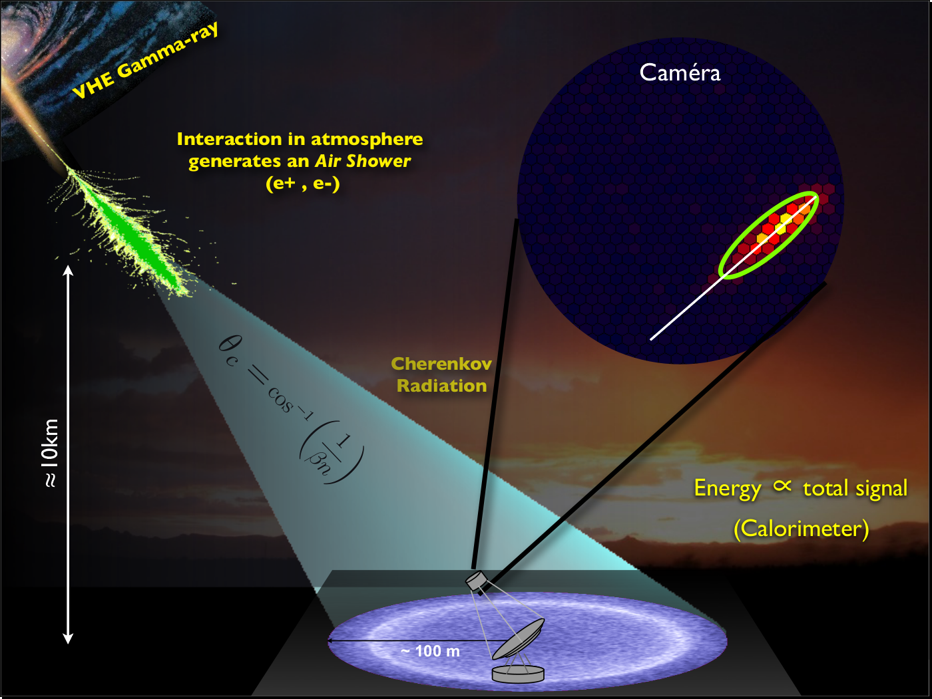
Shower Images (which may have time axis)
must be de-noised and parameterized
for reconstruction
Notes:
so images have to be denoised prior to be parametrized…
to get the origin and the trajectory of the shower

Slide 11
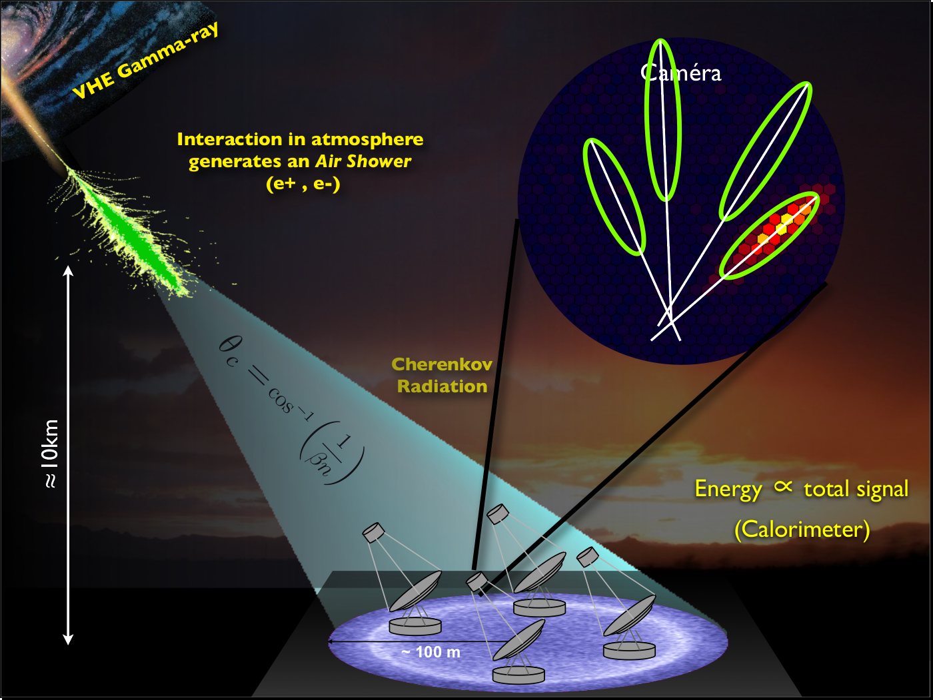
And then combined in Stereo
Notes:
And as we have several telescopes,
we can combine them to increase the accuracy of this reconstruction
By combining all those reconstructed events in time,
we can make sky maps of highly energetic sources

Slide 12
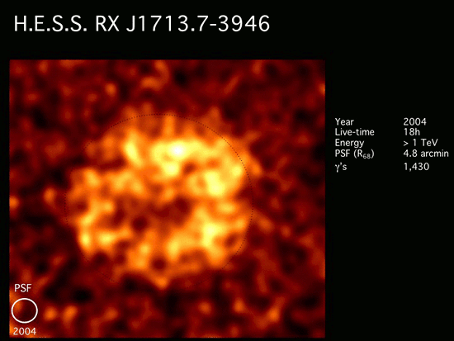
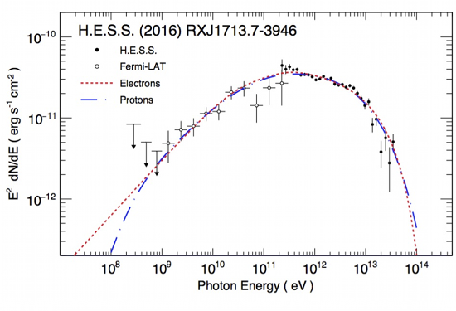
Sky maps
Very steep (≈E^{-2.5} spectra)
so low-energy threshold important
Could use this to show what a final sky map looks like (after reconstruction many 1000s of gamms rays)
This is a supernova remnant shell

Slide 13
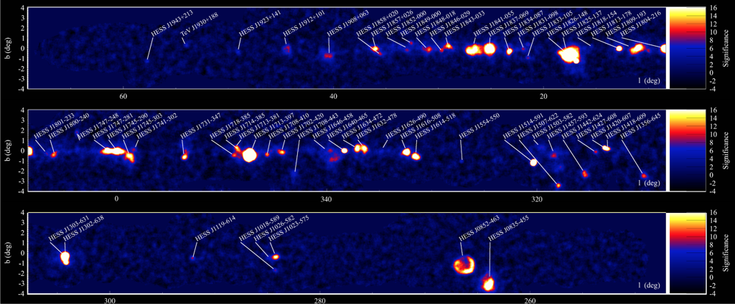
Sky maps

Slide 14
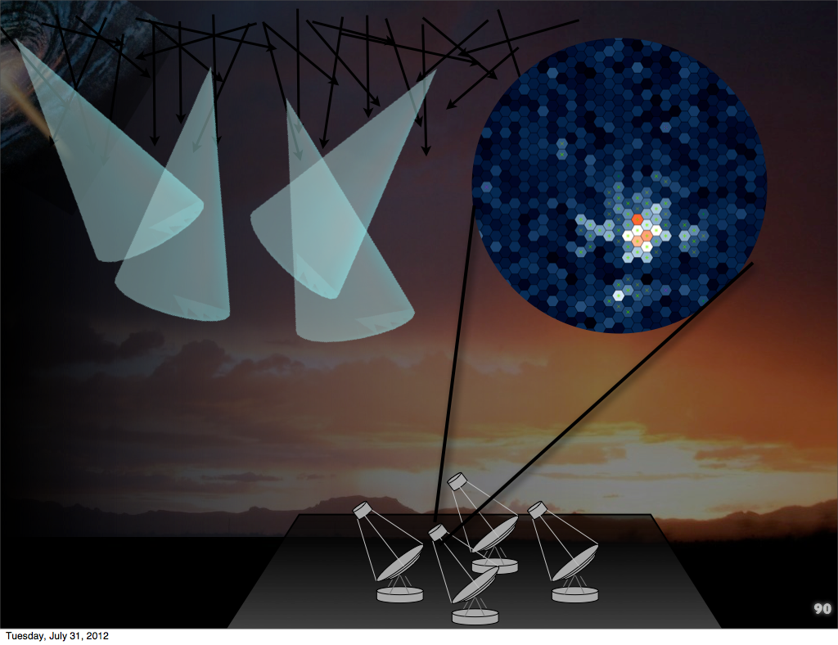
Cosmic Ray Background
dominates the gamma-rays by 5 orders of magnitude
Their images have a rougher morphology, which is difficult to distinguish due to low S/N
note this is an ideal case (reality is usually worse)
Notes:
Actually it's a bit more complicated to reconstruct events because
in addition to the night sky background I shown before,
most detected showers are not relevant for us
as they are caused by Hadrons (mostly protons).
This cosmic ray background dominates the gamma rays by 5 orders of magnitude
and their images are difficult to distinguish to gamma rays

Slide 15
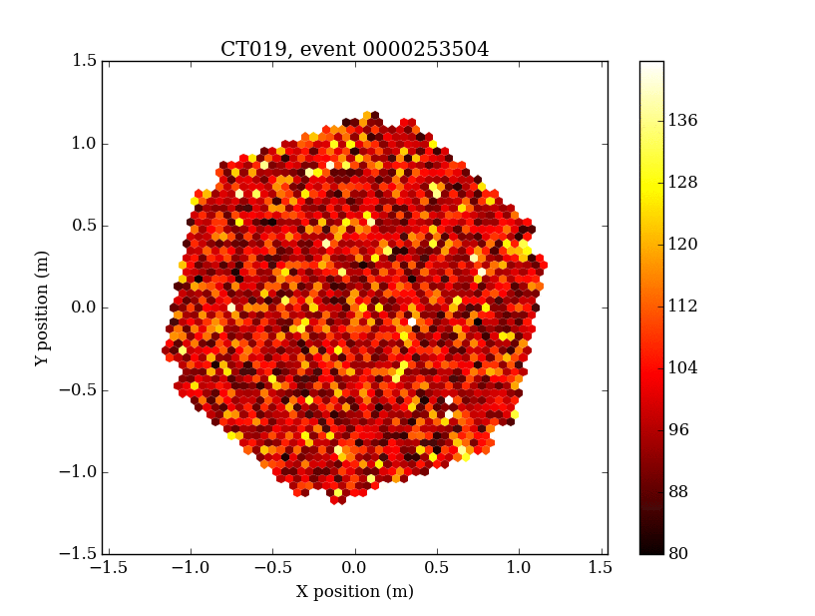
Examples
Gamma rays
Protons
Notes:
The time scale of these animations is few nano seconds

Slide 16
PROJECT:
Focus on two aspects for Cherenkov Telescopes
Gamma-ray reconstruction and discrimination
Better de-noising and image characterization
Improve PSF and energy threshold
Improve data volume reduction with less loss for CTA (factor of 100x needed)
Realtime transient detection
Wide field-of-view
Changing detector conditions (atmosphere)
Complex detector response
Reduce reliance on calibration and pre-calculated instrumental response functions
Notes:
Our project focus on two aspects for Cherenkov telescopes :
... and …
for …
we want a better …
we want to improve PSF... that is to say we want to be able to detect fainter events
we also want to get a better real time discrimination between Hadrons and gamma rays in order to highly reduce the data volume that will be huge with CTA : 10Gb/s
For transient detection, we have
…
It’s less sensitive to instrumental calibration (these alterations are large scale effects)

Slide 17
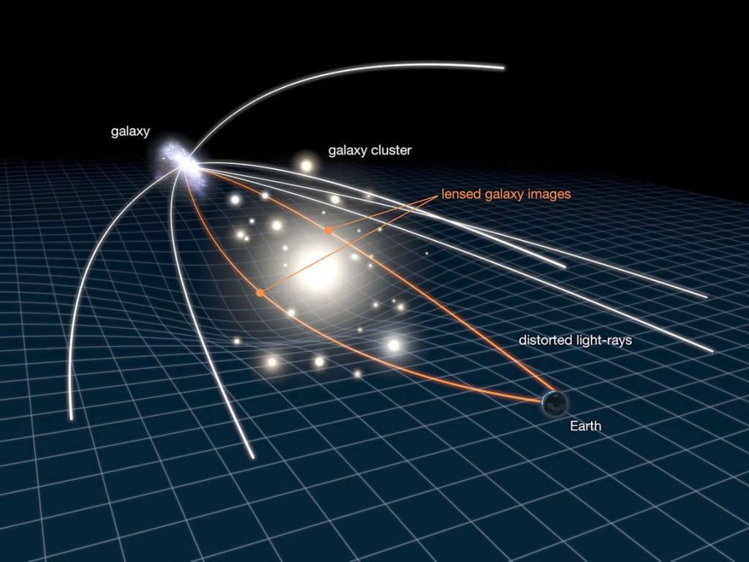
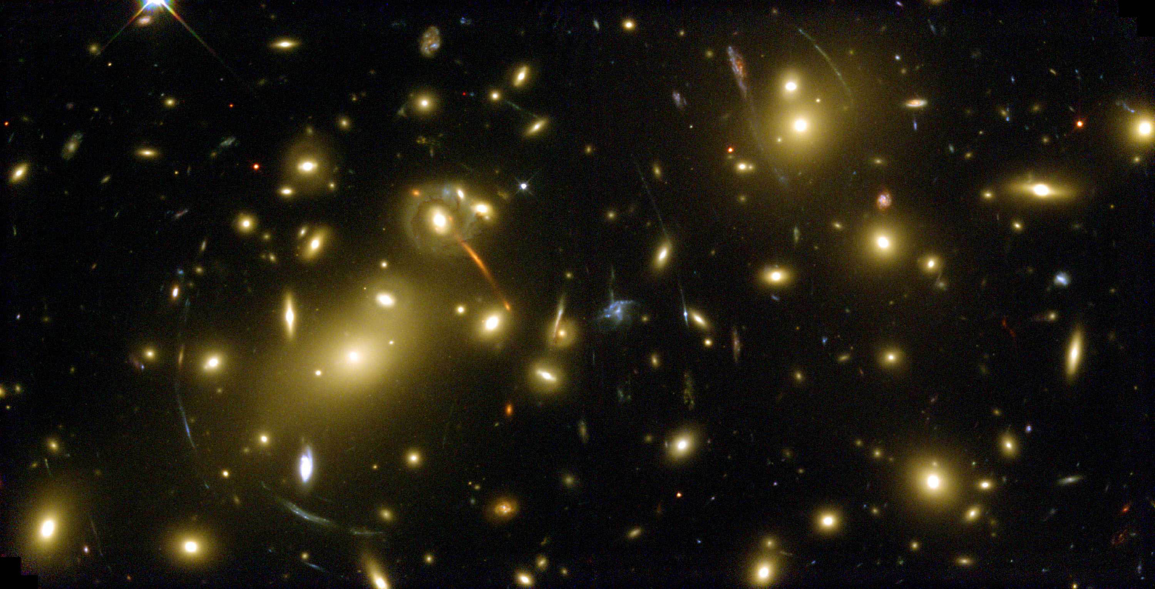
THE IDEA:
Synergies with Other Fields
An example: Weak Gravitational Lensing
Look for and parameterize minute shears in images of galaxies
Galaxy images are low Gaussian signals on high-noise background
This is nearly identical to the problem we have when reconstructing Cherenkov-light images of showers
Very different physics, same mathematics…
The techniques developed for Weak lensing are far more advanced than what are currently used for gamma rays and can be exploited
denoise + calculate moments, skewness, kurtosis for millions of [galaxy|shower] images on poisson background and reconstruct underlying distribution
e.g "Weak Lensig Mass Reconstrcution using Wavelets", J.-L. Starck, S. Pires, and A. Refregier, A&A, 451, 3, 1139-1150, 2006
Notes:
the idea of our project is to make synergies with other fields.
For instance, in CEA,
a cosmology group study weak gravitational lensing
that is to say they study the bending of some galaxy images caused by massive objects... (Euclid)
These images are Gaussian like signal on a high noise background
This is a nearly idendical problem to our,
the physics is very different but the maths are the same.
Thus as ... it would be a good idea to exploit them

Slide 18
Methods currently used for gamma rays images cleaning
A very simple cleaning procedure:
Keep pixels above a given threshold (e.g. 10 photoelectrons)
Keep some neighbors of these selected pixels: those above a second (lower) threshold (e.g. 5 photoelectrons)
Notes:
Here is an example of methods currently used ...
...
Fast and simple
Good enough for bright showers
But not for faint showers

Slide 19
Example of more advanced methods developed for weak gravitational lensing
Sparse image and signal processing:
Remove noise in direct space can be difficult
Remove noise in the transformed space can be easier (Fourier, Wavelets, ...):
noise is uniformly distributed on small coefficients
signal is defined by few big coefficients
Notes:
Here is an example of more advanced method ...
Sparce image and signal processing
So roughly the basic idea is to
apply a transform on the signal
then apply a threshold in the transformed space
and finally invert the transform to go back to the original signal space
To illustrate this, we have here a very basic example for an easy 1D signal using Fourier transform:
On the left, we have a noised signal
Here we have the representation of this signal in the Fourier space
We can see that it’s a good representation for this example
The noise is uniformly distributed on small coefficients
And the original signal is defined by one bigger coefficient
So in this space, it’s much simpler to separate the noise and the original signal
So we apply a threshold in this space
That is to say we set to 0 coefficients that are below this threshold
And we invert the transform to go back to the original signal space
And we finally get a clean signal

Slide 20
Advantages
Sparse methods:
Wavelets
Curvelets
Shearelets
Shapelets
...
Better noise separation
Keep large and small scales
Gamma/Hadron discrimination
Fainter features
Notes:
These sparse methods have several advantages...
They permit a better...
They keep ...
They can handle gamma/hadron separation
And fainter features

Slide 21
Example: Image cleaning with wavelets

Slide 22
Example: former Image cleaning method

Slide 23
Progress in events reconstruction (Tino Michael)
classical method
Notes:
Y axis: the PSF (Point spread function)
The lower the better
X axis: the number of telescopes that have detected the signal
To sum up, wavelets improve the PSF compared to the classical method

Slide 24
Progress in transient detection (Fabio Acero)
Notes:
Here are progress in transiant detection (by Fabio Acero) on a transient simulation
On the left we have the results of the signal cleaning with a basic derivative method
And on the right the results using wavelets
With wavelets we can retrive the actual peak of the signal

Slide 25
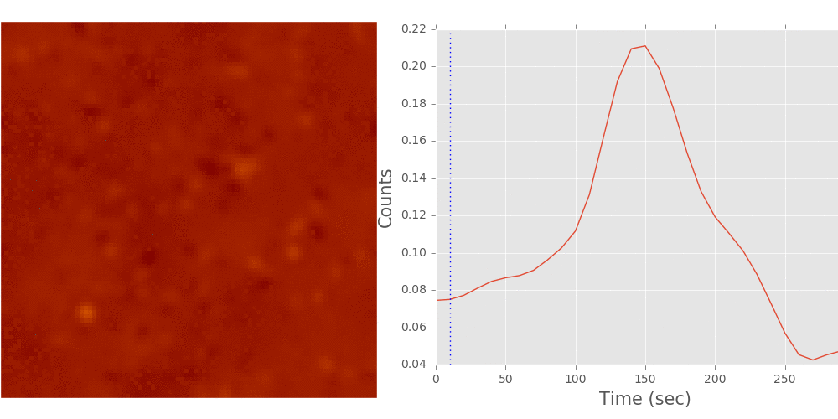
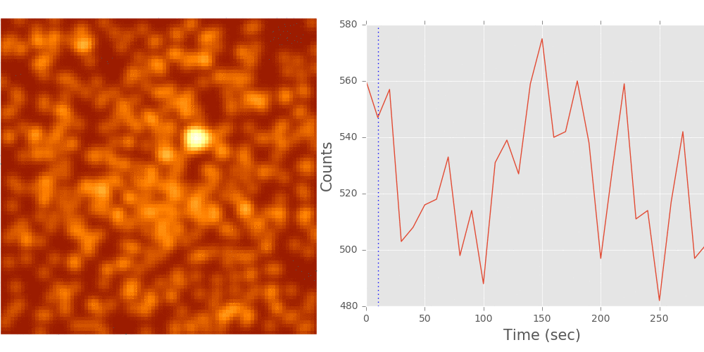
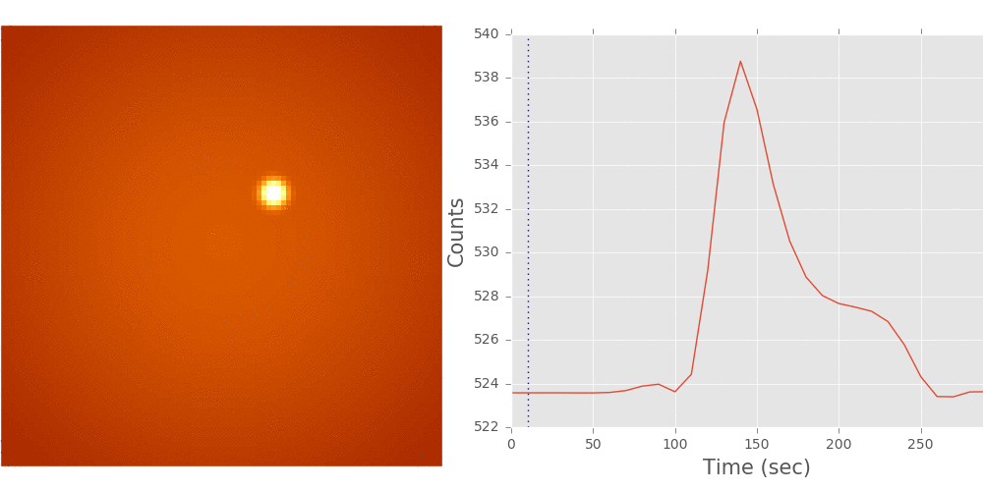
Progress in transient detection (Fabio Acero)
Toy model
Toy model + noise
Cleaned toy model with wavelets
Notes:
toy model
toy model + noise
cleaned toy model

Slide 26

Project:
PLan/timeline
 | Q1 2015 | Q2 2015 | Q3 2015 | Q4 2015 | Q1 2016 | Q2 2016 | Q3 2016 | Q4 2016 | Q1 2017 | Q2 2017 | Q3 2017 | Q4 2017 | Q1 2018
Postdoc Search
Postdoc employment |  |  |  | delay
Technique Study
Implementation & test (recon), simplified data
Implementation & test (recon) with realistic data |  |  |  |  |  |  |  | delay
Implementation & test (transients)
Final Validation |  |  |  |  |  |  |  | delay | delay
Technique Publication
Main Deliverables:
Code library adapted for use for Cherenkov Telescopes (open-source, python)
Validation report (plots and results for realistic data, MC for CTA or real for HESS if possible)
Publication on technique / documentation
Schedule notes:
Some unforeseen delays at start of project
Challenges to finish on time:
Adapt techniques to realistic data (see later)
Validation of technique
Notes:
We started the project with a short delay,
mostly for medical reason.
This is a work in progress but first results are promissing,
and we are basically on track for a publication next year.
Early results have been presented in an international meeting.
We mostly have to validate the technique and apply it to real data (hopefully the very first CTA data from ASTRI next year ?)
Validation of technique (results look promising, but some questions)
“recon” = reconstruction
Pkoi pas HESS ?: format de donnees (hexagonal pixels) + collaboration not open, some team members cannot publish papers with HESS data without agreement

Slide 27
Summary
Modern signal processing techniques appear to be very useful for Cherenkov Telescope data
Improve PSF
Improve low energy sensitivity
Immediate applications to CTA and HESS
Perhaps provide faster data processing
This Work has piqued the interest of other members, started new projects and fostered inter-group work
Notes:
… especially to detect faint noisy signal
… like the Inaf group in Italy (Fabio, Tino)
This work has developped a strong collaboration with the cosmostat team

Slide 28
Thank you

Slide 30
Subject
Try to improve image cleaning before reconstruction (Hillas)
Improve methods to remove:
Instrumental noise
Background noise
Motivations:
Keep more signal (deeper into the noise)
Reduce threshold
Maybe eventually do cleaning and time-integration all at once

Slide 31
The “Tailcut clean” algorithm
A very simple cleaning procedure:
Keep pixels above a given threshold (e.g. 50% max)
Keep some neighbors of these selected pixels: those above a second (lower) threshold (e.g. 25% max)

Slide 32
Remarks
Fast and simple
Sufficient for bright showers
But surely we can do better for faint showers

Slide 33
Basic idea to go beyond
Tailcut method: threshold in the main space
Better idea: threshold in a different space where signal and noise can be easily separated
Wavelet transform
Cosmostat tools (iSAP/Sparse2D)
(http://www.cosmostat.org/software/isap/)

Slide 34
We are considering Wavelet Transform method
Roughly the same idea than doing filtering with Fourier Transform
Apply the transform on the signal
Apply a threshold in the transformed space
Invert the transform to go back to the original signal space
Differences with Fourier Transform
Use functions named wavelets instead sin and cos functions as new bases in the transformed space
The transformed space contains spatial information

Slide 35
Example of wavelet function (Morlet wavelet)
“A short wave-like oscillation with a beginning and an end”

Slide 36
Cleaning procedure: general idea with Fourier Transform
Input signal is converted to a weighted sum of sin and cos at different frequencies
Threshold is applied on these weights to remove some frequencies in the input signal (e.g. high pass filter, low pass filter, ...)

Slide 37
Cleaning procedure: general idea with Wavelet Transform
Input signal is converted to a weighted sum of these wavelet functions at different scales (dilate factor) and positions (translate factor)
Threshold is applied on these weights to remove locally (in space or time) some frequencies (or scales) in the input signal

Slide 38
Find a base where signal and noise can be easily separated
In this example:
Remove noise in direct space is difficult
Remove noise in the transformed space is easy:
noise is uniformly distributed on small coefficients
signal is defined by few big coefficients

Slide 39
Example

Slide 40
Example

